Slide 1

Municipal Energy Tracking
Skyler Brown, Christina Chen, and Evelyn Lane
Sam Lash, CVRPC
Maddison Shropshire, ACRPC
8 December 2022
Howard E. Woodin Colloquium
Notes:
Hello, We are presenting today with our outcomes on Municipal Energy Tracking
Central Vermont Regional Planning Commission
Addison County Regional Planning Commission;

Slide 2
90%
Renewable Energy
20%
Renewable Energy
v.
By 2050
Vermont State Energy Goals
(2016 Comprehensive Energy Plan)
Current Energy Consumption
Energy Action Network
(2022 Annual Report)
Notes:
Attention Getter
State energy goals vs what current use looks like
Need: Difference between actual and desired situations
Close this gap → we need to develop energy efficiency projects
In order to do so, we need to understand current energy use and where we can make improvements → we need good data
Problem: no real energy data infrastructure, no protocol or way consistent way for municipality to keep track and record their energy use

Slide 3







Raw Data
Gas receipts
Electric bills
Gallons of propane burned
Etc.
Municipal Energy Use
Tracking & Baseline Template
Accessible spreadsheet
Streamlined data entry
Automatic conversions and calculations
Establish energy use baseline
Analyze change over time
Organized & Comprehensive Record of Energy Use
Including all municipal assets
Multiple years
Amount, cost, & pollution
Encourages efficiency
Notes:
Task: What was asked to do to address the need
Create a template for tracking and baseline
Targeted for specific needs that we identified with the partner
Really explaining what the template is
Main Message: the one sentence I want my audience to remember
Ultimately, we created an energy tracking template for municipalities to clearly log and analyze their energy use

Slide 4
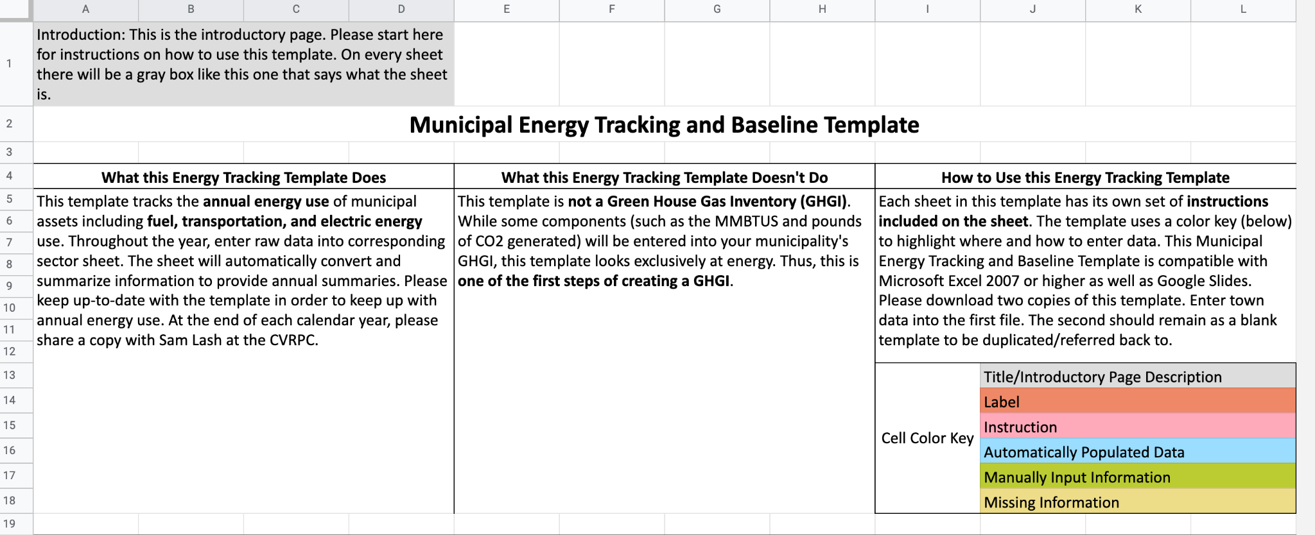
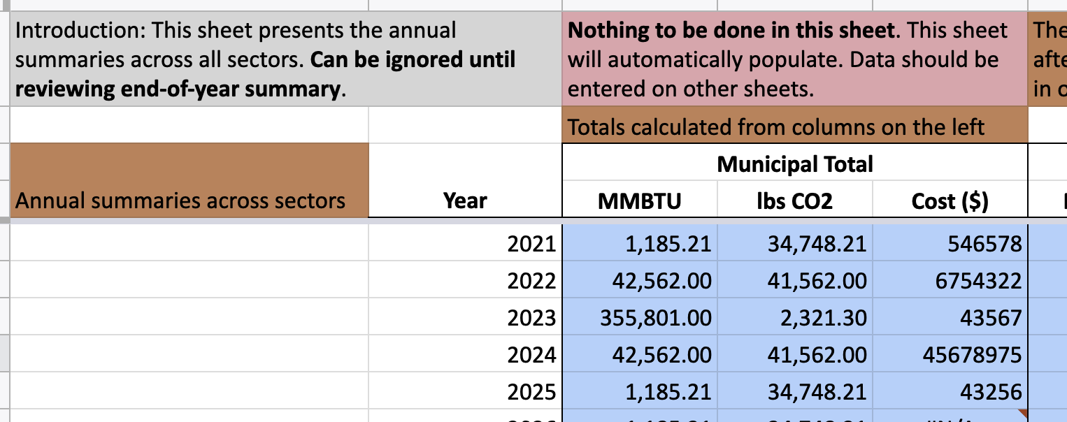
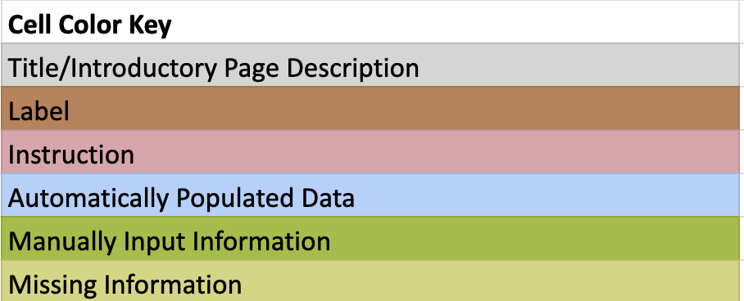
Municipal Energy Use Tracking & Baseline Template
Notes:
Diving into what the template actually looks like
Currently only tracks municipally owned assets
The primary summary page is this one that displays three sectors, electricity, fuel, and transportation annual use

Slide 5
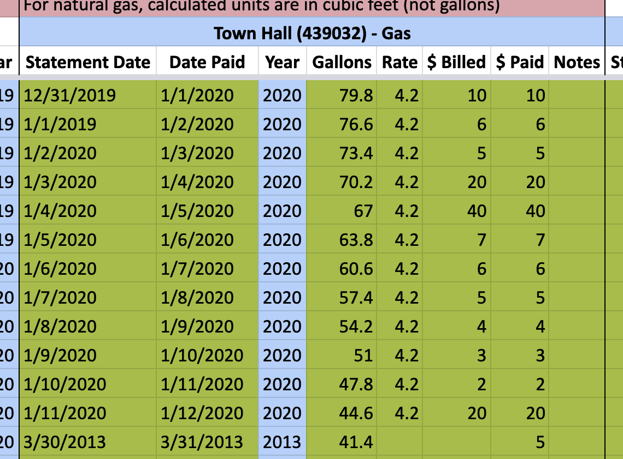
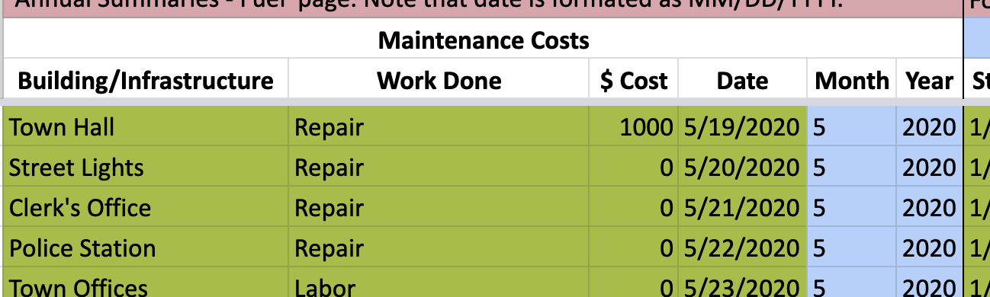
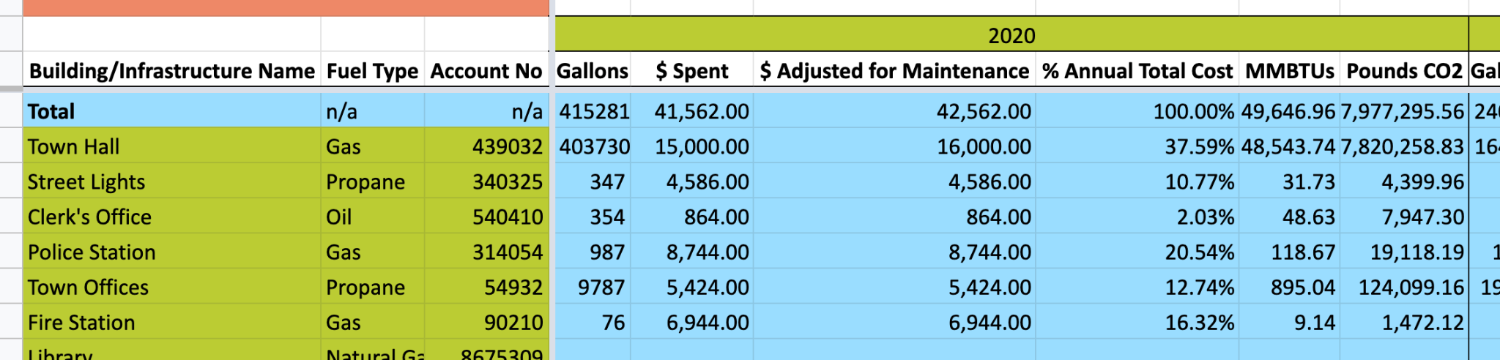
Municipal Energy Use Tracking & Baseline Template:
Fuel
Bills
Fuel Summary
Notes:
Main points
What does the template look like

Slide 6
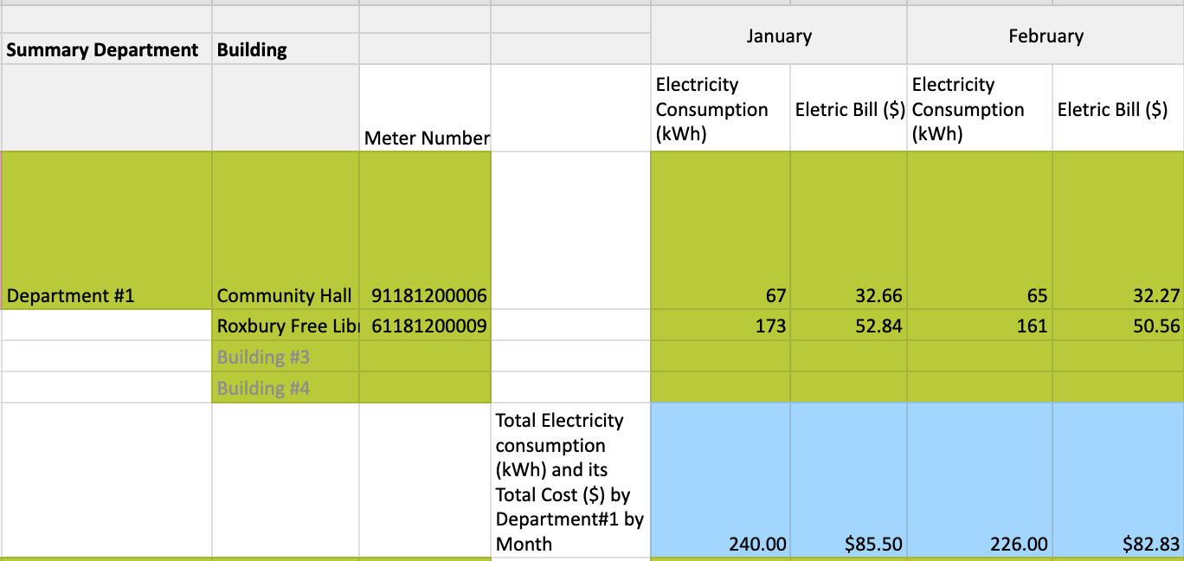
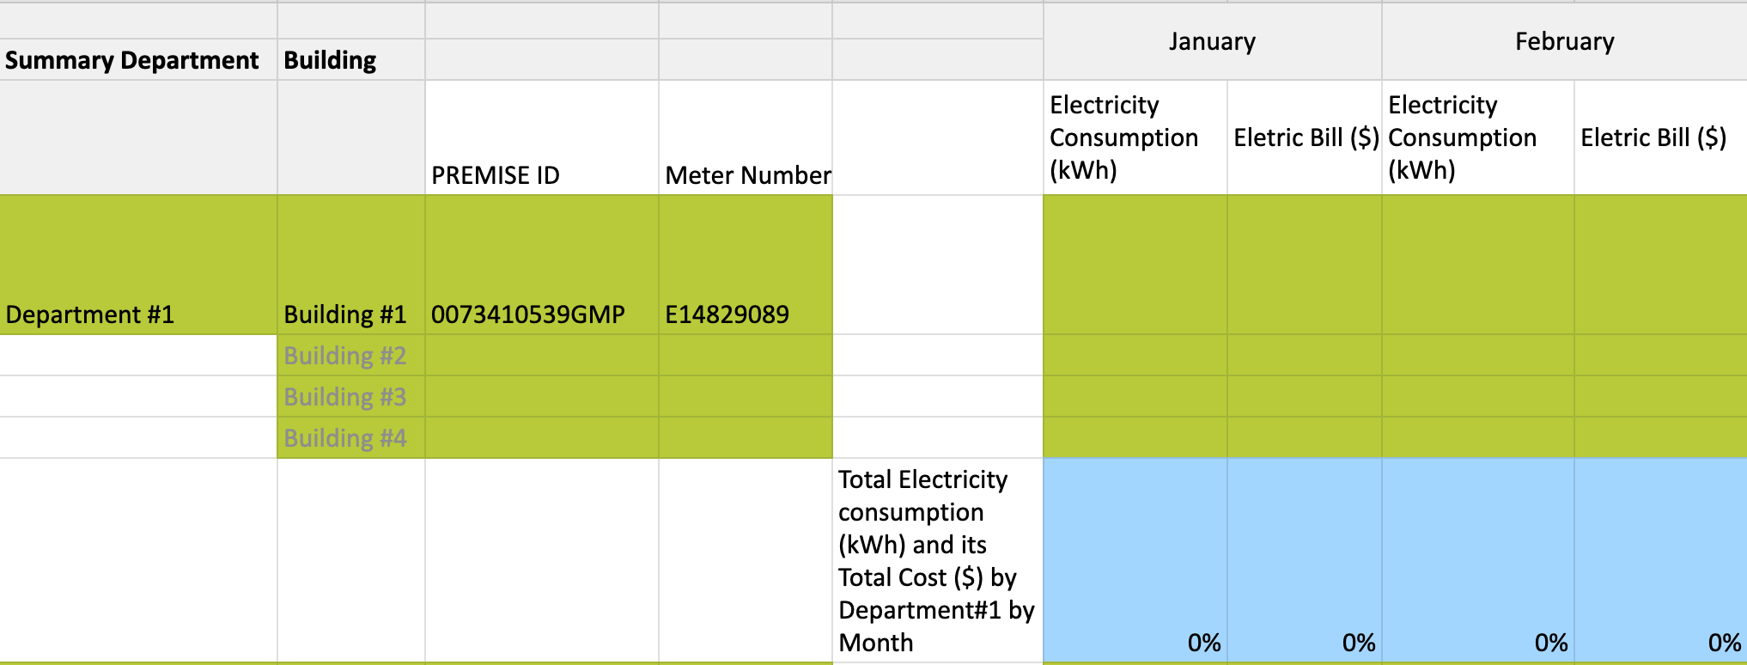
Municipal Energy Use Tracking & Baseline Template:
Electric
Non-renewable energy only

Slide 7
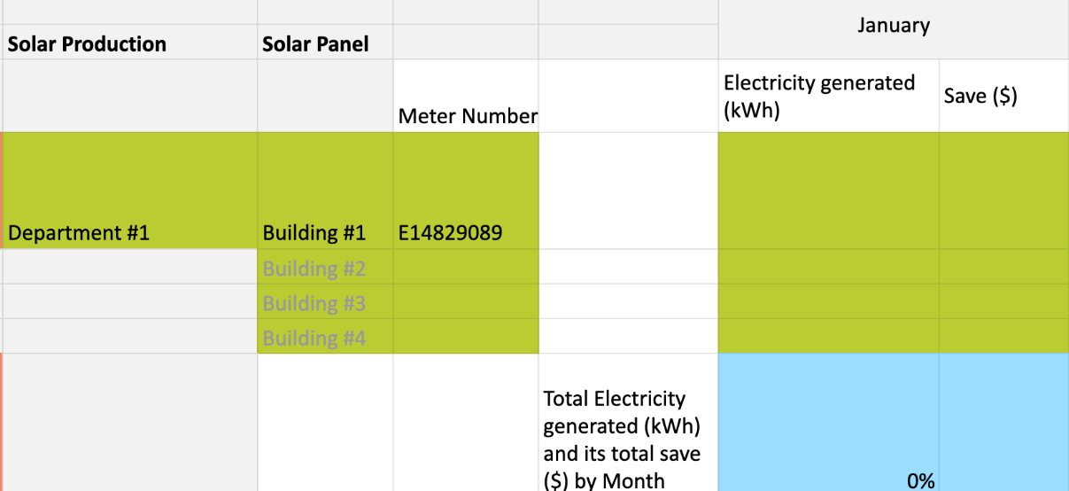
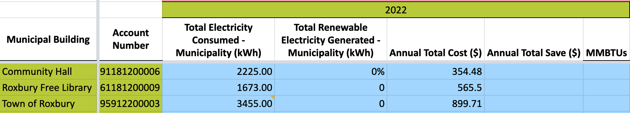
Municipal Energy Use Tracking & Baseline Template:
Electric cont.
Notes:
Main points
What does the template look like

Slide 8
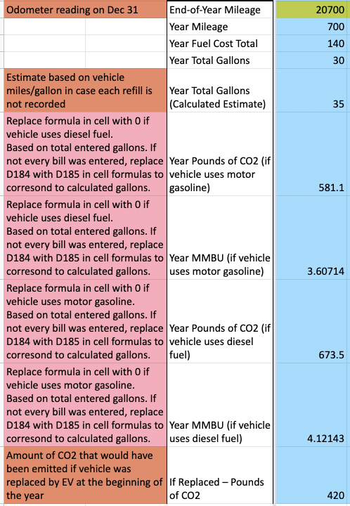
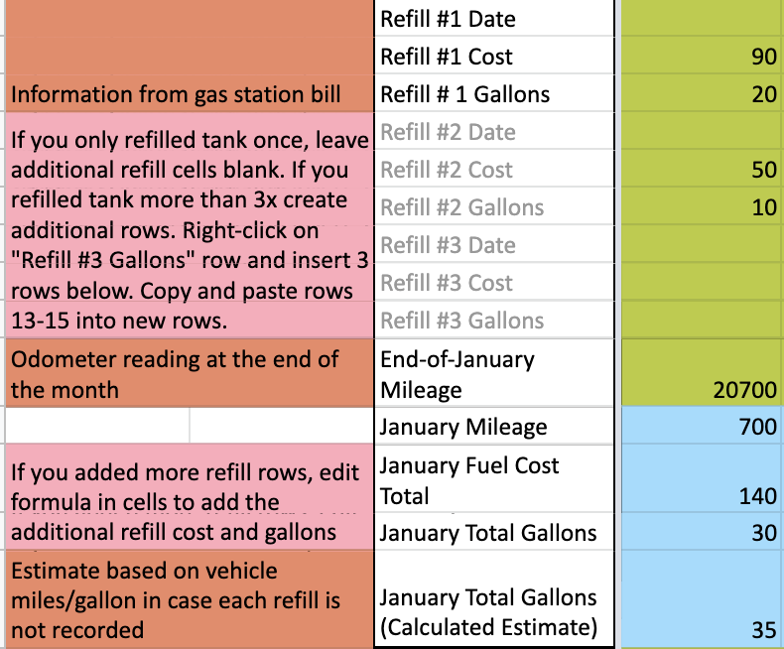
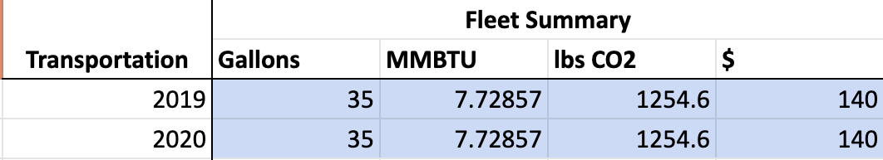
Municipal Energy Use Tracking & Baseline Template:
Transportation
Info from gas receipts
Pounds of CO2 created by vehicle
Pounds of CO2 created by EV driving same miles
Notes:
Main points
What does the template look like

Slide 9
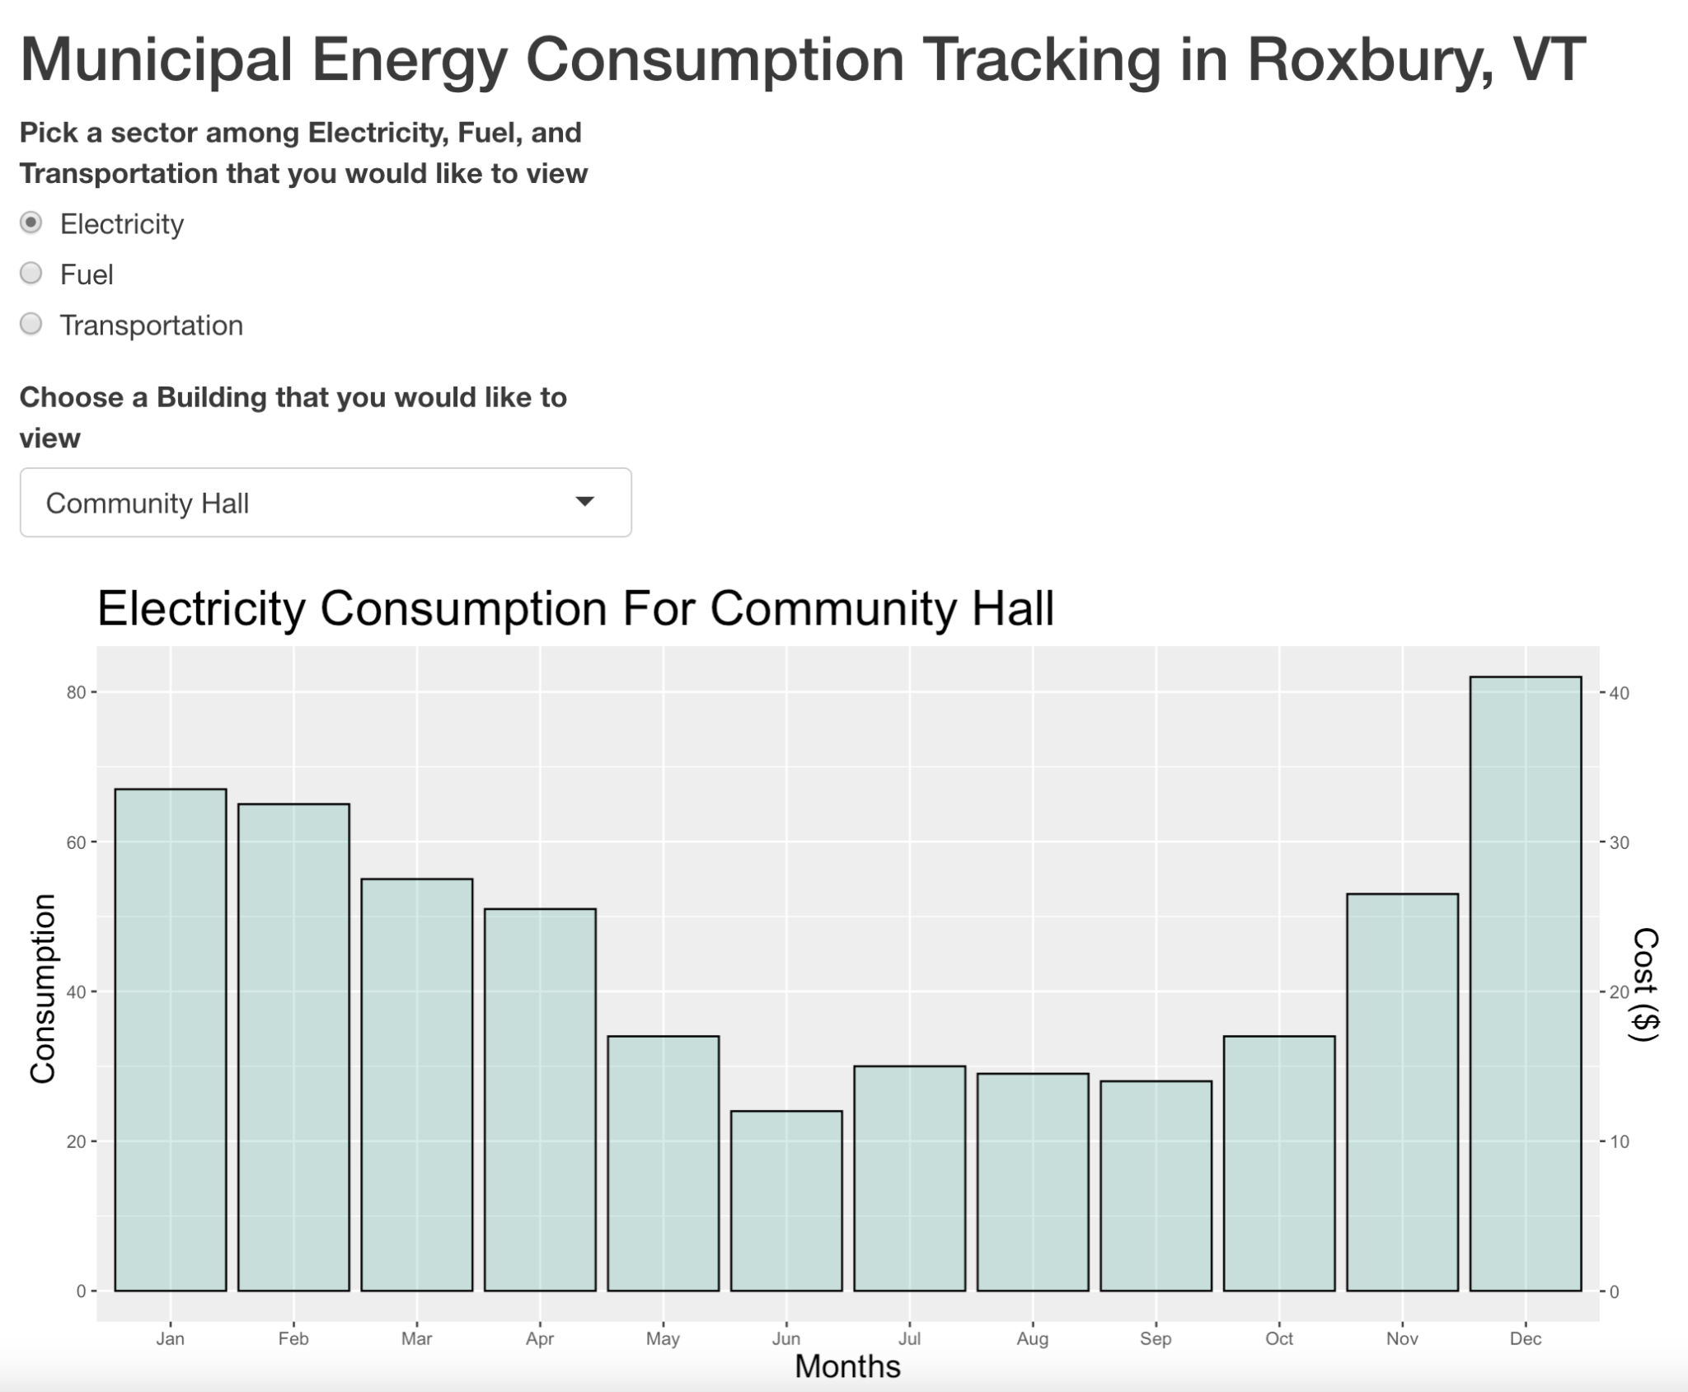
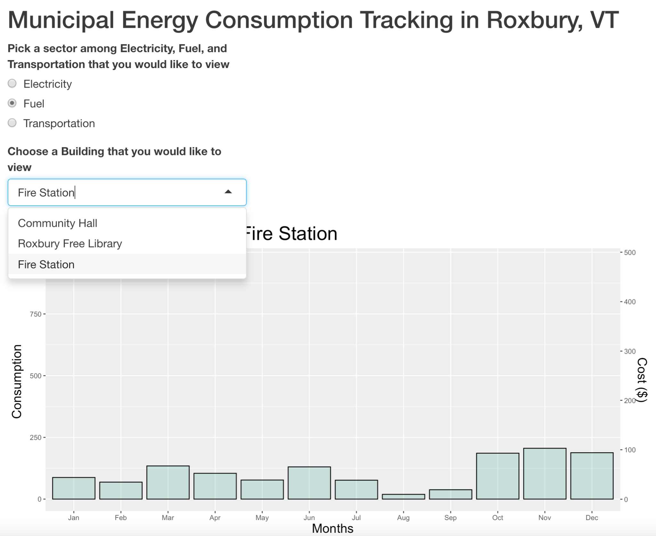
Interactive graphs for visualization – Shiny App
Notes:
Attention Getter
State energy goals vs what current use looks like
Need: Difference between actual and desired situations
Close this gap → we need to develop energy efficiency projects
In order to do so, we need to understand current energy use and where we can make improvements → we need good data
Problem: no real energy data infrastructure, no protocol or way consistent way for municipality to keep track and record their energy use

Slide 10


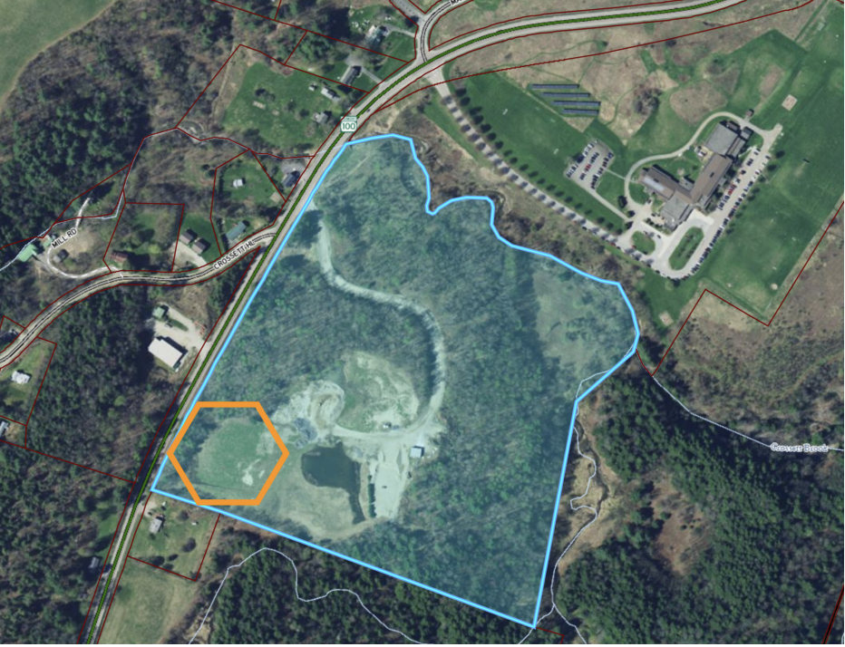
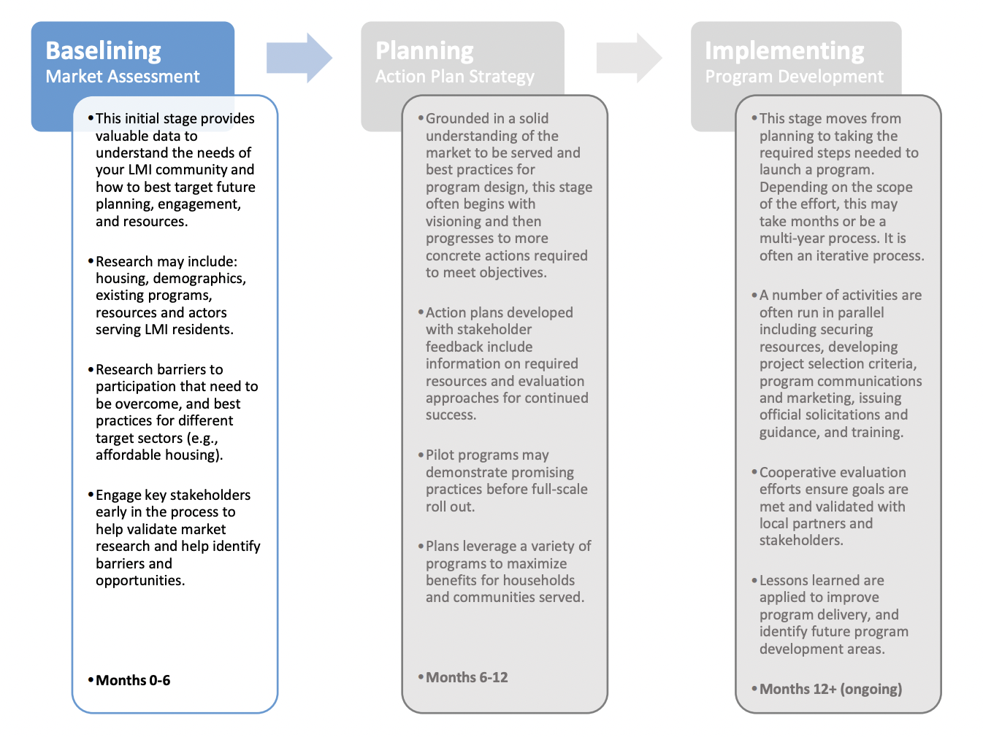

Purpose & Applications
Duxbury, VT
Town Gravel Pit Solar Development Project
Notes:
Main points
Use/applications
Future steps aka GHG inventory

Slide 11
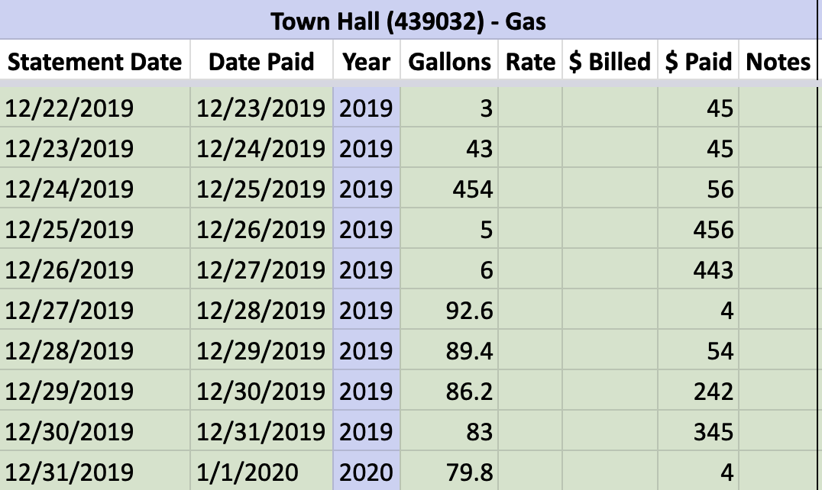
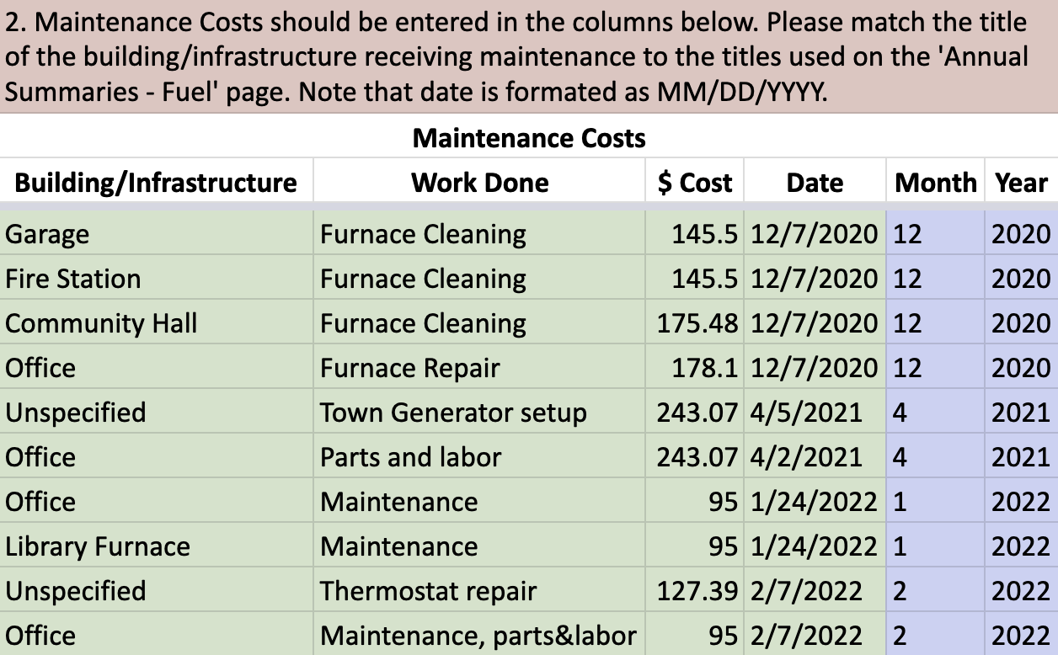
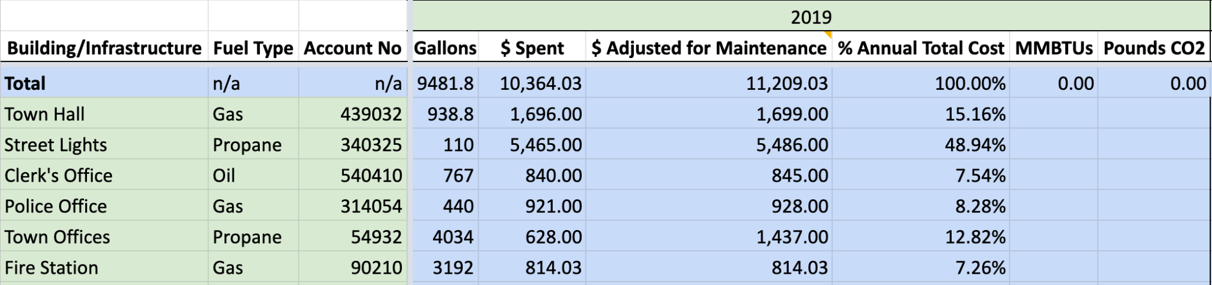
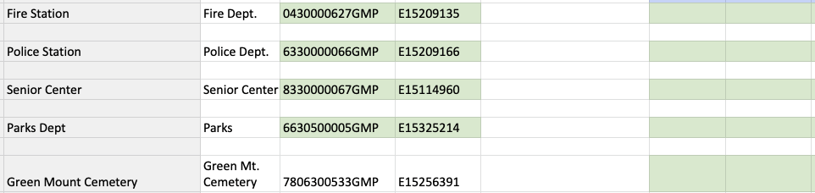
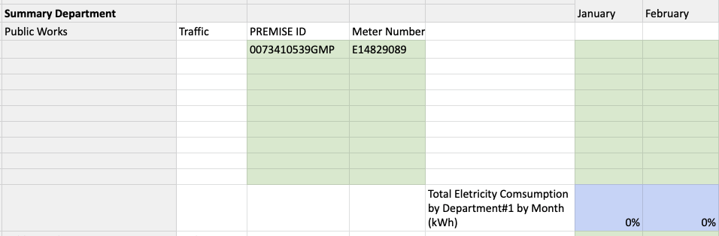
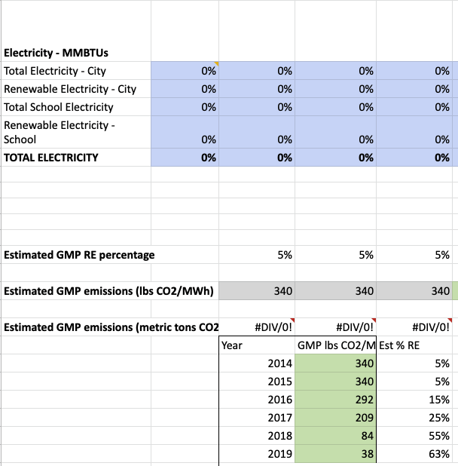
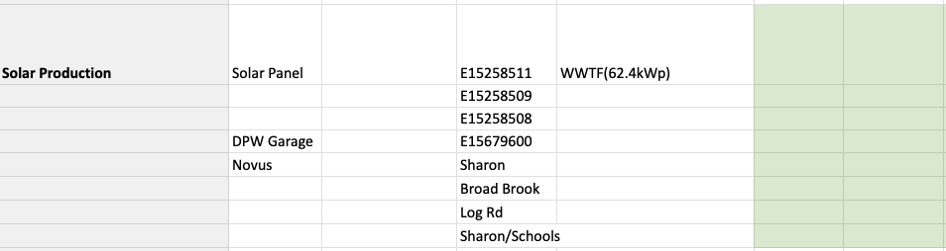
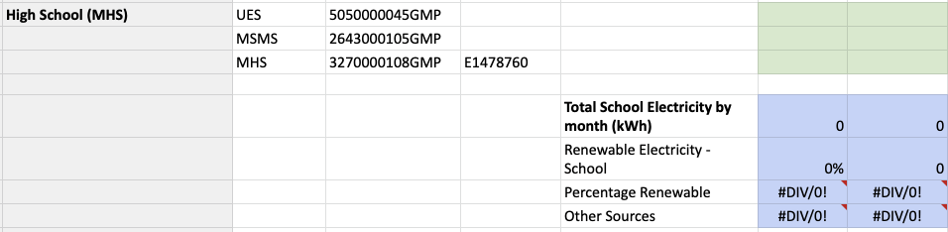
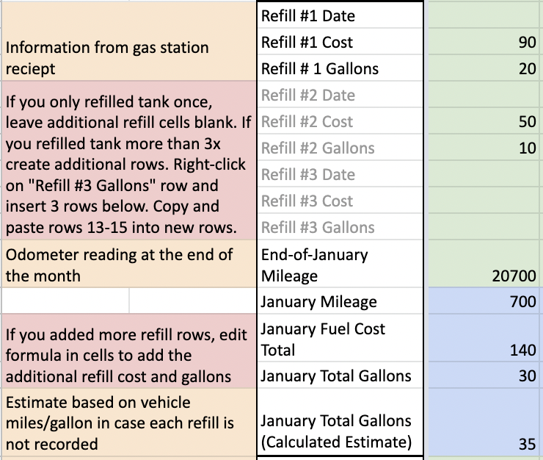
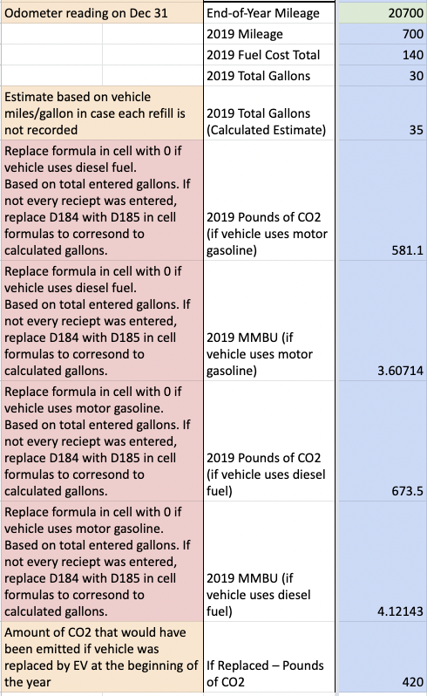
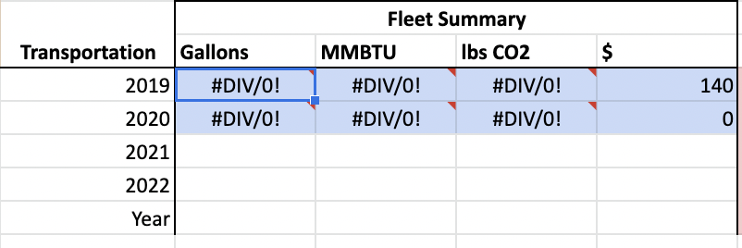
Reaching Vermont Energy Goals
Notes:
Review: a recap of the body, leading into the conclusion
Research and outreach to identity what needed to be included
Template provides a clear data entry protocol and automatic analysis of energy use and impact
Our template will be given to our partner and municipalities to serve as the basis of a local energy data infrastructure
Conclusion: what the above means to the audience in the end
Understanding current use and providing a benchmark is the first step towards improving energy efficiency
Set up municipalities to develop energy efficiency projects and apply for funding and other opportunities

Slide 12
Acknowledgements
Sam Lash
Maddison Shropshire
Roxbury Town
Richard Hopkins and Duncan Krepps
ES Faculty and Staff
Prof. Kate Crawford
Prof. Diane Munroe
Our wonderful classmates in ES401
Up Next: Weatherization and Tenant Protection

